Slide 1

Chapter 7 Running on a Cluster
CSC 4760 / 6760 Big Data Programming
Spring 2020
Source Code:
https://github.com/databricks/learning-spark
src/python/ChapterSixExample.py

Slide 2
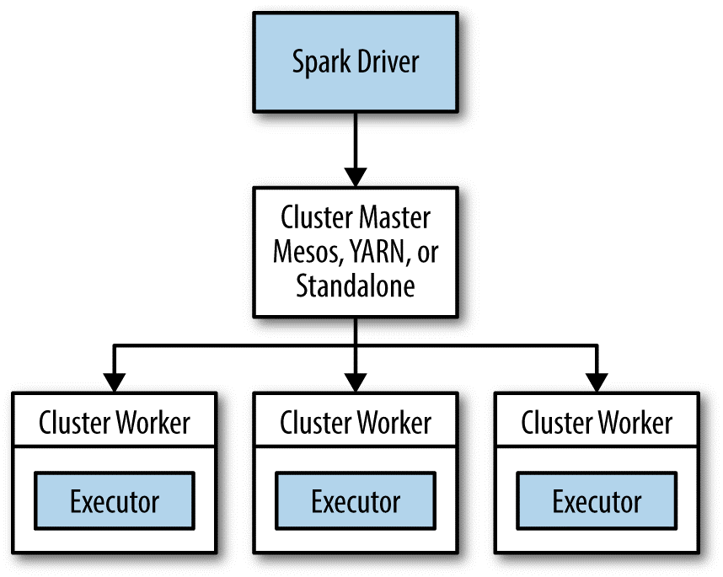
Spark Runtime Architecture
one central coordinator
Master/Slave architecture
The driver runs in its own Java process
Each executor is a separate Java process
many distributed workers
Cluster Managers
Built-in: Standalone cluster manager
Hadoop YARN
Apache Mesos

Slide 3
The Driver
The main() method runs in this Java process (driver).
It creates a SparkContext, creates RDDs, and performs transformations and actions.
When you launch a Spark shell, you have created a driver program
Two Duties
Converting a user program into tasks
Scheduling tasks on executors
The driver exposes information about running Spark application through web interface:
http://localhost:4040

Slide 4
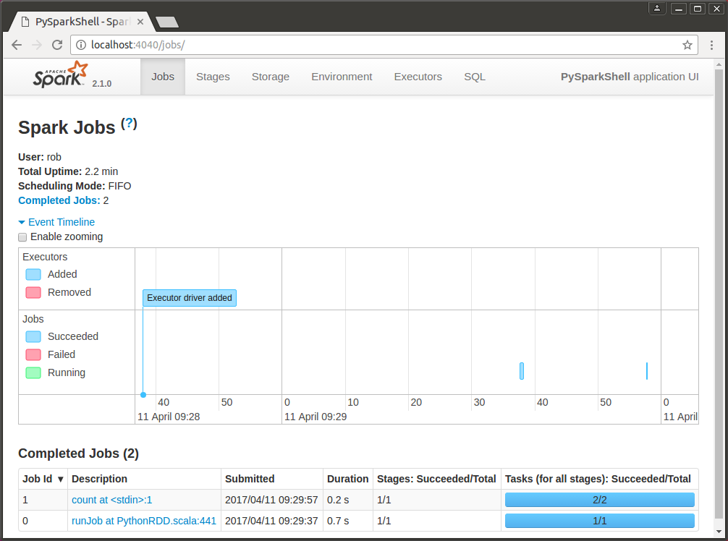
http://localhost:4040
pyspark
book = sc.textFile(“/home/rob/data/peterpan.txt”)
book.first()
book.count()

Slide 5
Executors
Spark executors are worker processes responsible for running the individual tasks in a given Spark job.
Two Roles:
They run the tasks and return results to the driver
They provide in-memory storage for RDDs that are cached by user programs

Slide 6

http://spark.apache.org/docs/latest/cluster-overview.html

Slide 7
Launching a Program – spark-submit
The user submits an application using spark-submit.
spark-submit launches the driver program and invokes the main() method specified by the user.
The driver program contacts the cluster manager to ask for resources to launch executors.
The cluster manager launches executors on behalf of the driver program.
The driver process runs through the user application. Based on the RDD actions and transformations in the program, the driver sends work to executors in the form of tasks.
Tasks are run on executor processes to compute and save results.
If the driver’s main() method exits or it calls SparkContext.stop(), it will terminate the executors and release resources from the cluster manager.

Slide 8
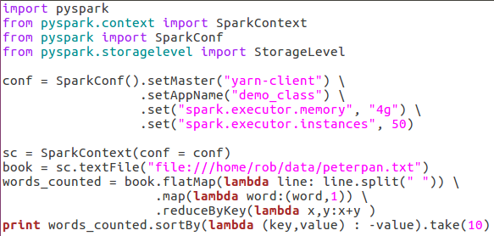
WordCount.py

Slide 9
Submitting a Python application
Command:
spark-submit WordCount.jar
spark-submit my_script.py
spark-submit WordCount.jar
General Format:
spark-submit [options] <app jar | python file> [app options]
With extra arguments
spark-submit --master spark://host:7077 --executor-memory 10g my_script.py
Arguments | Meaning
--master | A cluster URL to connect to
Spark://host:7077 | A cluster using Spark’s Standalone mode
--executor-memory | The memory allocated for each executor

Slide 10
Submitting a Self-contained application
Python:
spark-submit my_script.py
Java (runnable jar file):
spark-submit WordCount.jar
NOT java -jar WordCount.jar
Scala:
spark-submit --class edu.gsu.WordCount wordcount-0.0.1-SNAPSHOT.jar
R:
NOT java -jar worcount-0.0.1-SNAPSHOT.jar
spark-submit dataframe.R
Maven outputs: worcount-0.0.1-SNAPSHOT.jar
Developing and Running a Spark WordCount Application:
https://www.cloudera.com/documentation/enterprise/5-5-x/topics/spark_develop_run.html

Slide 11
Possible values for the --master flag in spark-submit
Value | Explanation
spark://host:port | Connect to a Spark Standalone cluster at the specified port. By default Spark Standalone masters use port 7077.
mesos://host:port | Connect to a Mesos cluster master at the specified port. By default Mesos masters listen on port 5050.
yarn | Connect to a YARN cluster. When running on YARN you’ll need to set the HADOOP_CONF_DIR environment variable to point the location of your Hadoop configuration directory, which contains information about the cluster.
local | Run in local mode with a single core.
local[N] | Run in local mode with N cores.
local[*] | Run in local mode and use as many cores as the machine has.
Submitting Applications:
https://spark.apache.org/docs/latest/submitting-applications.html

Slide 12
Submitting a Python application
General Format:
spark-submit [options] <app jar | python file> [app options]
Arguments | Meaning
[options] | a list of flags for spark-submit spark-submit --help => all possible flags
<app jar | python file> | JAR or Python script containing the entry point into your application.
[app options] | options that will be passed onto your application

Slide 13
Common flags for spark-submit
Flag | Explanation
--master | Indicates the cluster manager to connect to. The options for this flag are described in Table 7-1.
--deploy-mode | Whether to launch the driver program locally (“client”) or on one of the worker machines inside the cluster (“cluster”). In client mode spark-submit will run your driver on the same machine where spark-submit is itself being invoked. In cluster mode, the driver will be shipped to execute on a worker node in the cluster. The default is client mode.
--class | The “main” class of your application if you’re running a Java or Scala program.
--name | A human-readable name for your application. This will be displayed in Spark’s web UI.

Slide 14
Common flags for spark-submit
Flag | Explanation
--jars | A list of JAR files to upload and place on the classpath of your application. If your application depends on a small number of third-party JARs, you can add them here.
--files | A list of files to be placed in the working directory of your application. This can be used for data files that you want to distribute to each node.
--py-files | A list of files to be added to the PYTHONPATH of your application. This can contain .py, .egg, or .zip files.
--executormemory | The amount of memory to use for executors, in bytes. Suffixes can be used to specify larger quantities such as “512m” (512 megabytes) or “15g” (15 gigabytes).
--drivermemory | The amount of memory to use for the driver process, in bytes. Suffixes can be used to specify larger quantities such as “512m” (512 megabytes) or “15g” (15 gigabytes).

Slide 15
Example 1
# Submitting a Java application to Standalone cluster mode
$ ./bin/spark-submit \
--master spark://hostname:7077 \
--deploy-mode cluster \
--class com.databricks.examples.SparkExample \
--name "Example Program" \
--jars dep1.jar,dep2.jar,dep3.jar \
--total-executor-cores 300 \
--executor-memory 10g \
myApp.jar "options" "to your application" "go here"

Slide 16
Example 2
# Submitting a Python application in YARN client mode
$ export HADOOP_CONF_DIR=/opt/hadoop/conf
$ ./bin/spark-submit \
--master yarn \
--py-files somelib-1.2.egg,otherlib-4.4.zip,other-file.py \
--deploy-mode client \
--name "Example Program" \
--queue exampleQueue \
--num-executors 40 \
--executor-memory 10g \
my_script.py "options" "to your application" "go here"

